Slide 1
Chapter 2
Social Context of Computing

Slide 2
Society and Technology

Slide 3
Impact of Technology on society and vice versa
Innovation and change in all spheres of life and makes life convenient, economical and easier
Technology and development go hand on hand
Technology and stress are partners
Technology made mass communication possible but made people isolated from the society

Slide 4
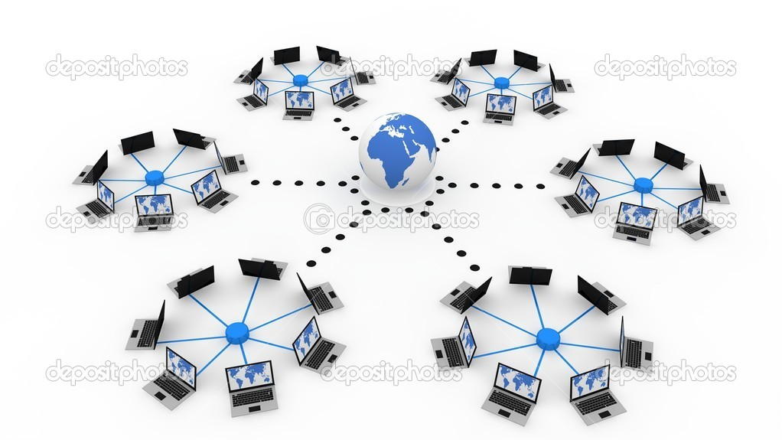

Slide 5


Slide 6
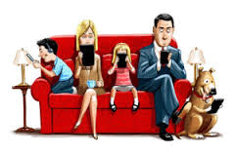

Slide 7
Using Technology for poverty alleviation
Definition by UN: “poverty is the inability of having choices and opportunities, a violation of human dignity. It means lack of basic capacity to participate effectively in society”
GDP per capita of Nepal last recorded as 689.81 $ in 2015
25% of Nepal population fall under poverty almost 50% of which in Far-western and mid-western regions
Extreme poverty: those living on less than 1$ per day

Slide 8
Technologies capable to alleviate poverty
Radio
Television
Telephone
Computers and the Internet

Slide 9
Strategies for poverty alleviation
Distribution of locally relevant information
Targeting disadvantaged and marginalized groups
Promoting local entrepreneurship
Improving poor people's health
Strengthening education
Promoting trade and e-commerce
Supporting good governance
Building capacity and capability
Enriching culture
Supporting agriculture
Creating employment opportunities
Reinforcing social mobilization

Slide 10
Heath related issues for an IT professional

Slide 11
Computer Related Health Hazards
Eye strain
Stress and depression
Back problems (pain) caused from the efforts of the muscle to hold your posture for long periods of time
Skin rashes that are caused from the static fields in front of the screen causing ions and pollutants in the air to become positively charged and attach themselves to your negatively charged skin (especially in low humidity)
Abnormal reproductive outcomes due to electromagnetic radiation's affects on biological functions and biochemical processes inside our cells
Cancer
Skin aging
Internet Addiction

Slide 12
Ergonomics
Ergonomics, the "science of work," is a field of technology that considers human capabilities and limitations in the design of machines and objects that people use, the work processes that they must follow, and the environments in which they operate."

Slide 13
A few ergonomic advice
Use a chair that has full support of your back, is adjustable, and has a footrest and armrest
Place your feet firmly on the floor
Use an ergonomic keyboard that is angled or can split to enjoy a more natural typing position
Use a wrist rest that is comfortable
Place your hands straight when typing, the angle of your forearm and upper arm should be 90 degrees
Sit 24 to 28 inches away from your monitor
Place the monitor 15-30 degrees below your straight-ahead line of sight
Keep your body away from the sides and backs of monitors to reduce the exposure of radiation
Avoid glare on your monitor (do not have strong sources of light in your back) and use screens that minimize glare
Use the proper light in your work environment that is compatible with the monitor frequency

Slide 14
Internet and Society

Slide 15
Digital divide and bridging the digital divide
- “refers to the gap between individuals, households, businesses and geographic areas at different socio-economic levels with regard both to their opportunities to access information and communication technologies (ICTs) and to their use of the Internet for a wide variety of activities”
- reflects various differences among and within countries

Slide 16
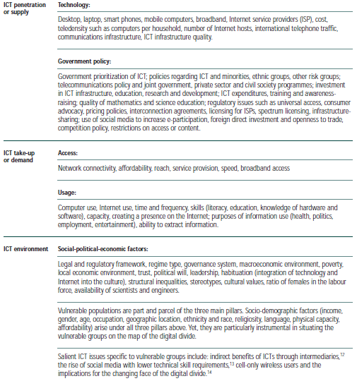
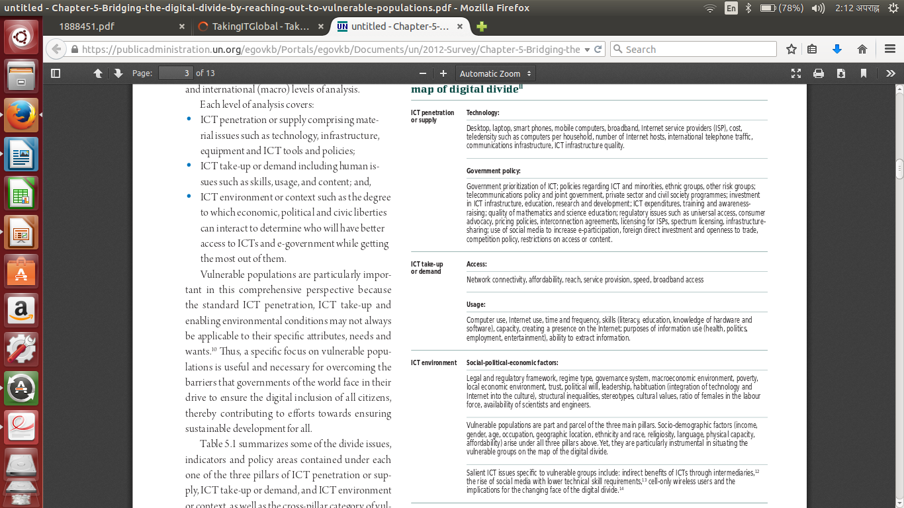

Slide 17
Governance of Internet
- Internet governance is the development and application of shared principles, norms, rules, decision-making procedures, and programs that shape the evolution and use of the Internet
- Internet governance refers to the processes that impact how the Internet is managed
- Governance mechanism relies on users, business and governments

Slide 18
E-governance and E-Government Systems

Slide 19
e-Government
“e-Government” refers to the use by government agencies of Information and Communication technologies that have the ability to transform relations with citizens, businesses, and other arms of government.
- These technologies can serve a variety of different ends: better delivery of government services to citizens, improved interactions with business and industry, citizen empowerment through access to information, or more efficient government management.
-The resulting benefits can be less corruption, increased transparency, greater convenience, revenue growth, and/or cost reductions.

Slide 20
Characteristics of e-government
Electronic service delivery
Electronic Work flow
Electronic Voting
Electronic Productivity
Types of e-government
G2G
G2C
G2B
G2E

Slide 21
e-Governance
“e-Governance/digital Governance refers to
governance processes in which Information and
Communications Technology (ICT) play an active
and significant role”
- e-governance deliver SMART governance
S- Simple
M- Moral
A-Accountable
R- Responsive
T -Transparent

Slide 22
Characteristics of e-governance
Electronic Engagement
Electronic Consultation
Electronic Controllership
Networked Societal Guidance

Slide 23
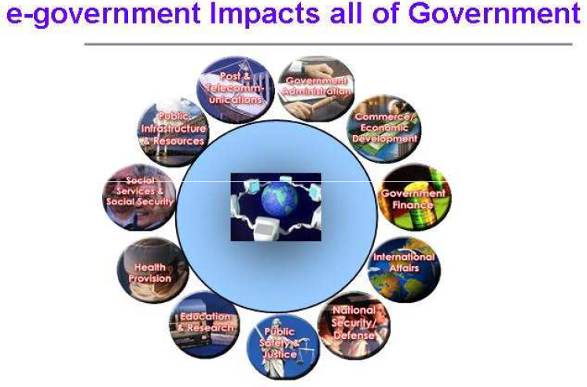

Slide 24
